Slide 1
The Onion Report
The Tor Project
HOPE July 20, 2018

Slide 2
Let’s meet our panelists

Slide 3
Title Slide

Slide 5
Title
Body

Slide 6
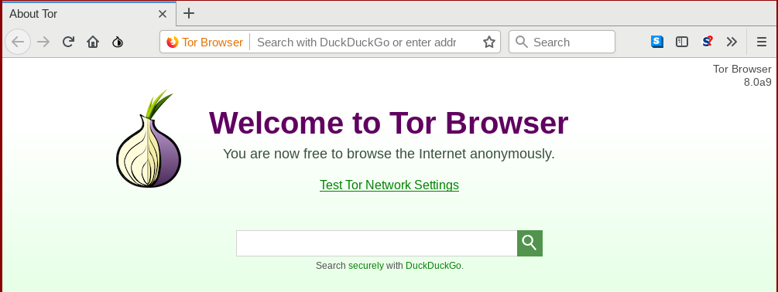
New Tor Browser Version

Slide 7
Increased Usability

Slide 8
Increased Usability

Slide 9
Tor Browser for Android

Slide 10
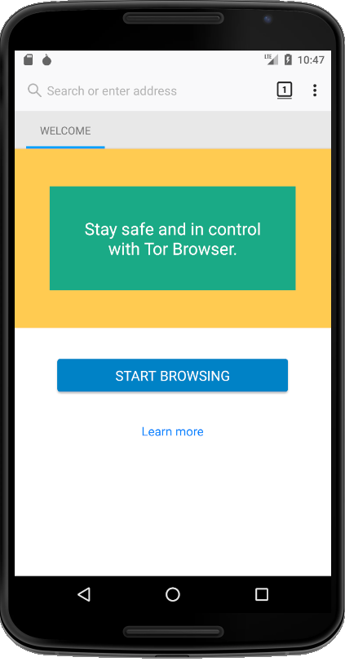
Tor Browser for Android

Slide 11
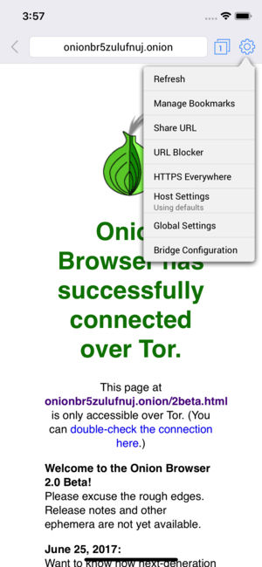
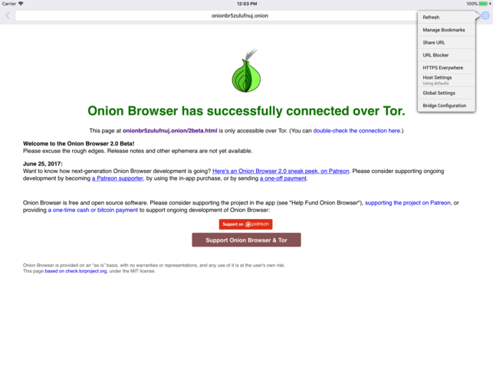
Onion Browser!

Slide 12
It’s time for questions!
torproject.org
torproject@lists.torproject.org

